Slide 1
Hangman Game
Group 2
PROJECT BY:
Abhinav Yadav
Varenya Girish Hegde
Yashvardhan Shukla

Slide 2
Previous status:
Animation on running of code showing HANGMAN.
Level 1 game.
Hint displayed in Hindi language to guess the word.
Score and Lives are displayed on top right corner.
Alphabet keys giving outputs.
Restart and Quit button popup after loosing.

Slide 3
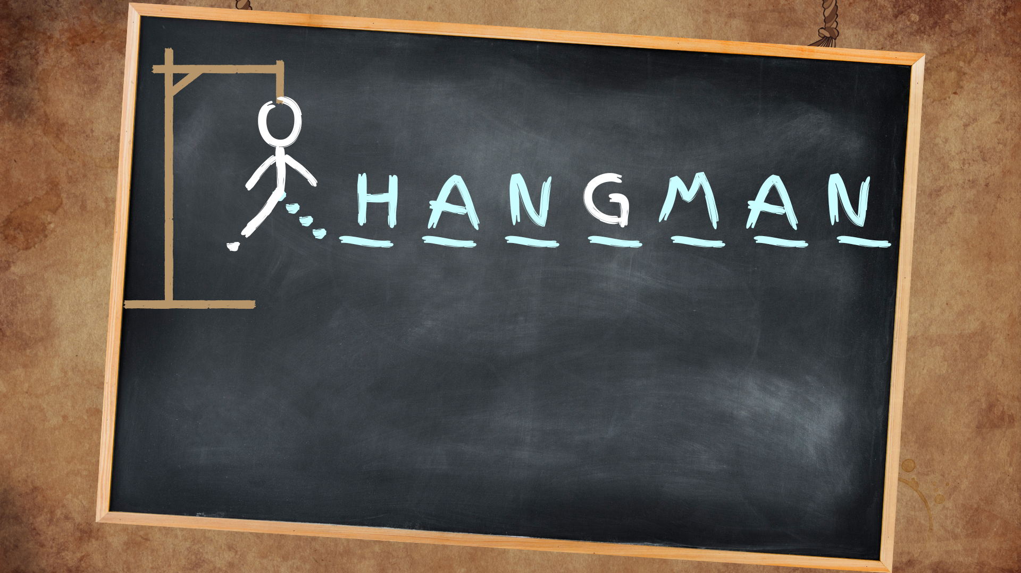
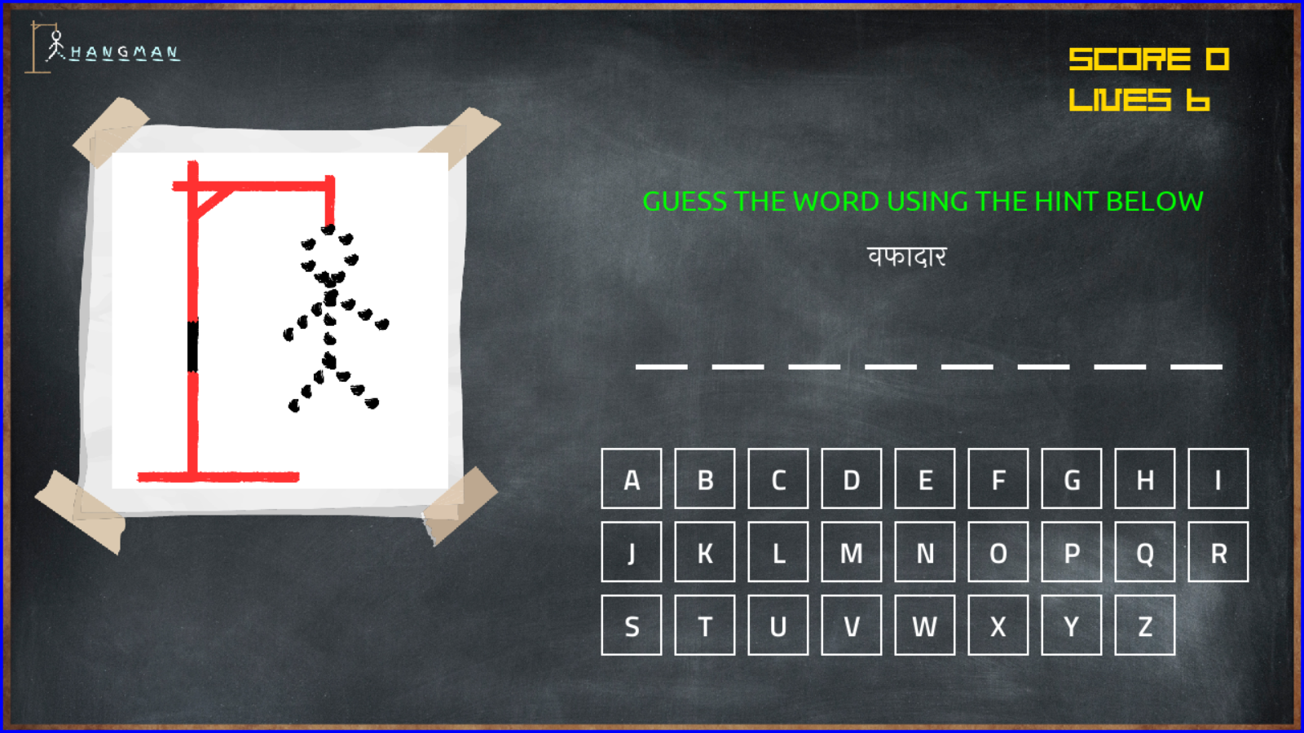
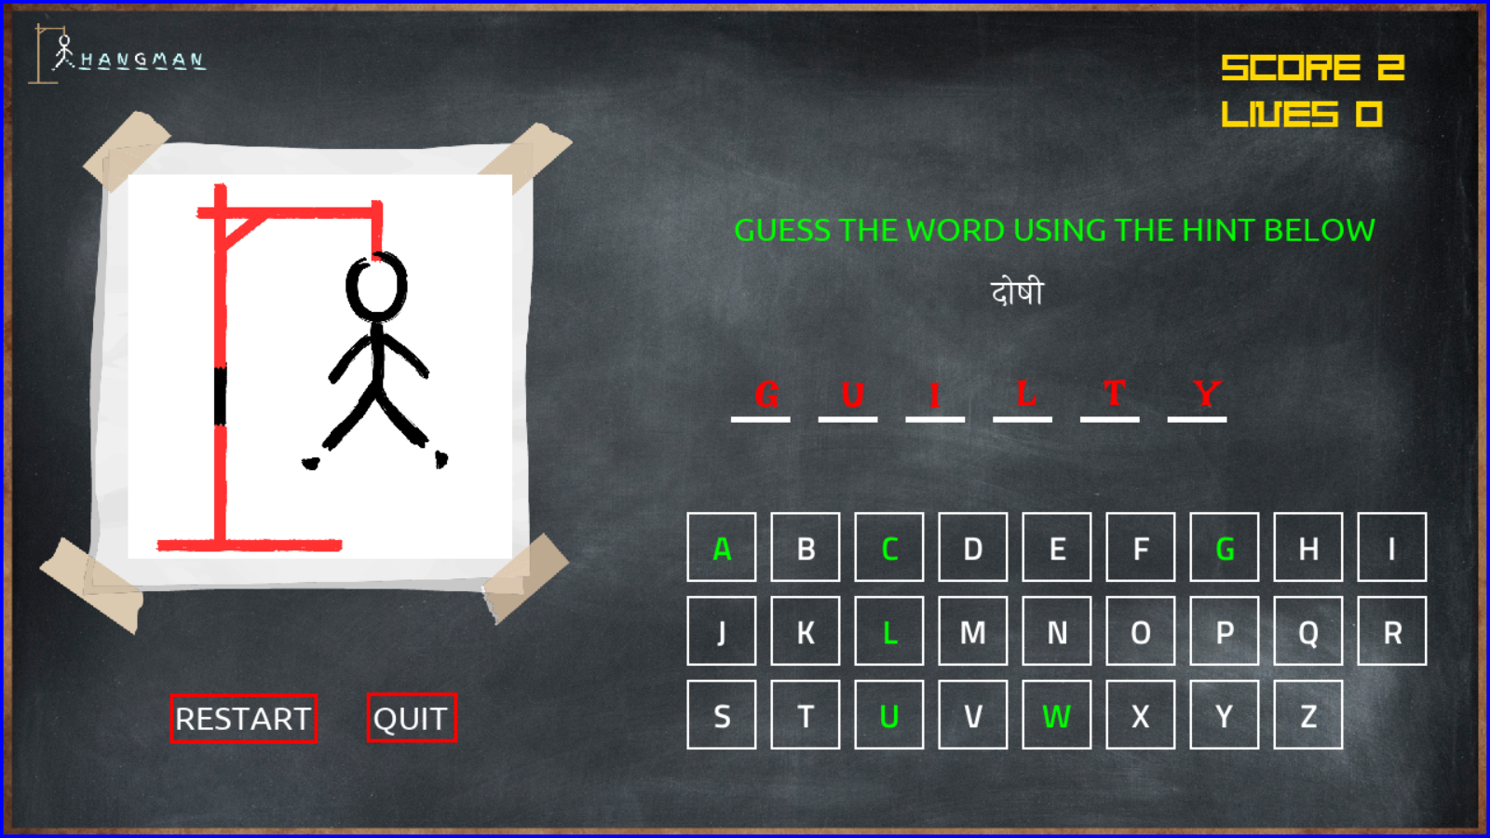
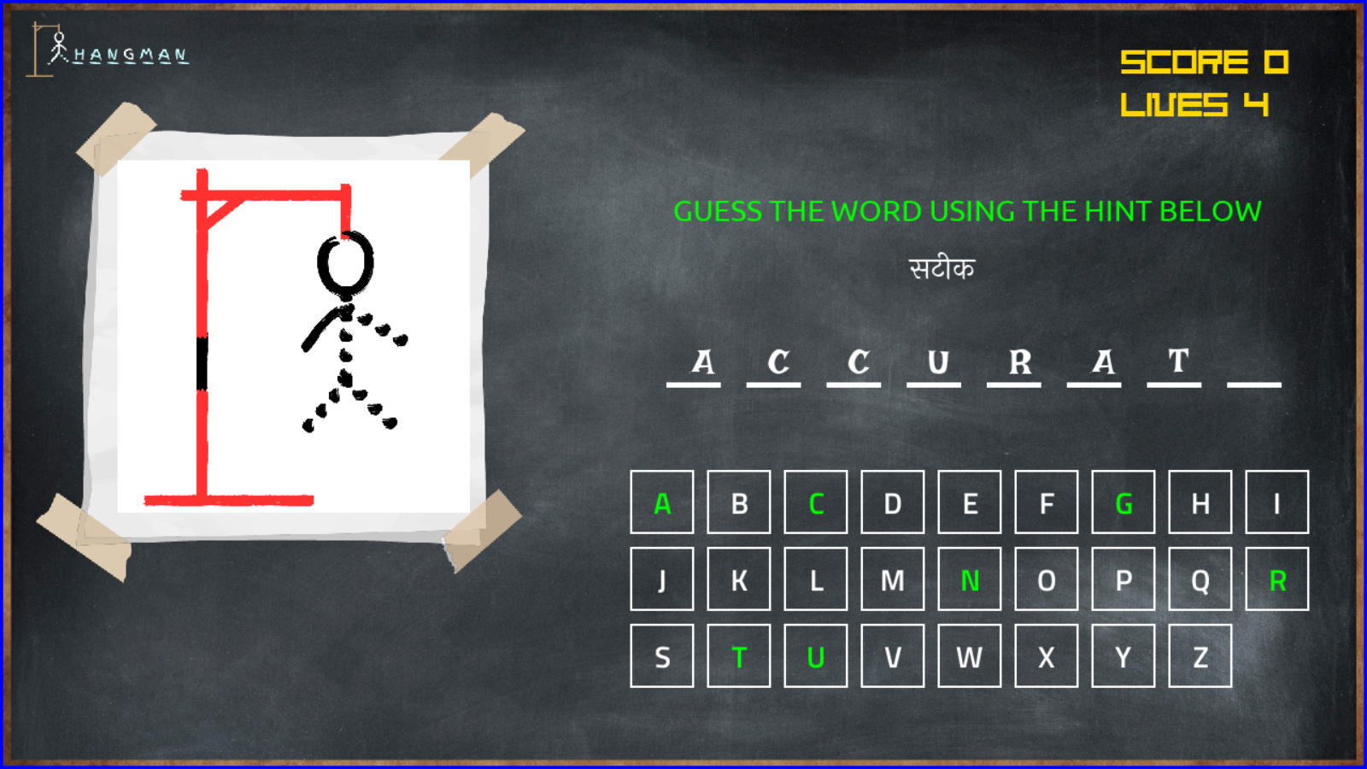
Previous status output :

Slide 4
Present status
Created menu options
Fixed bugs in scores
Working on levels.
Created text files for different levels.

Slide 5
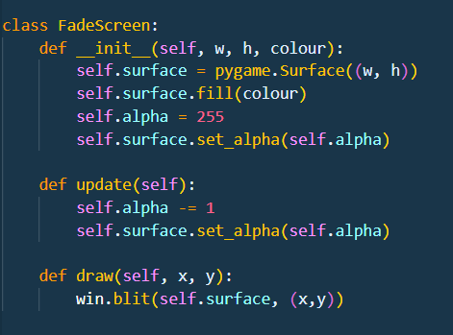
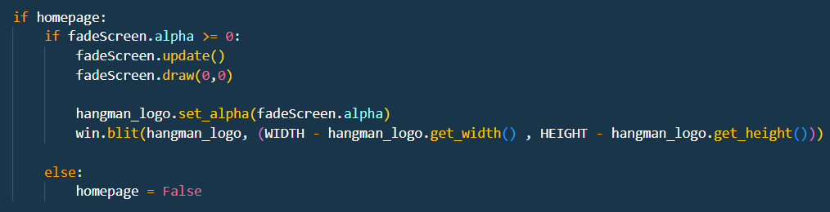
Current status output:

Slide 6
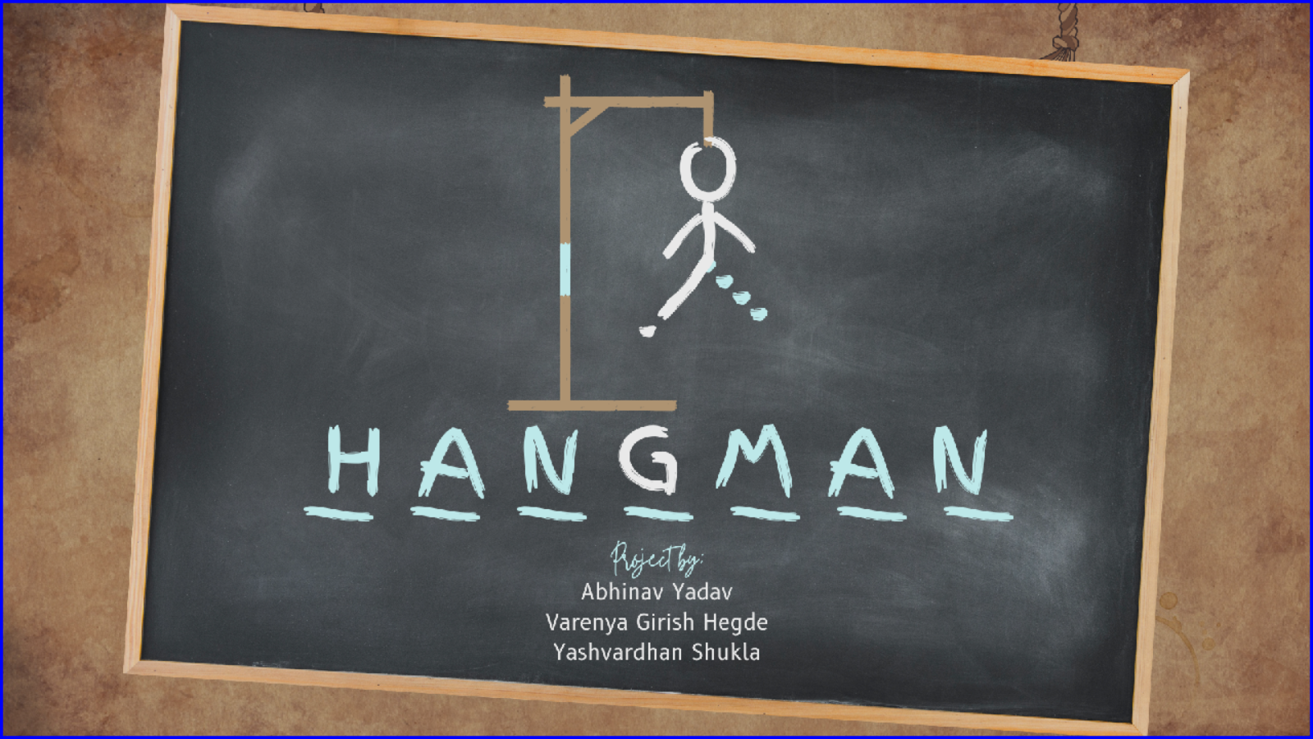

Slide 7
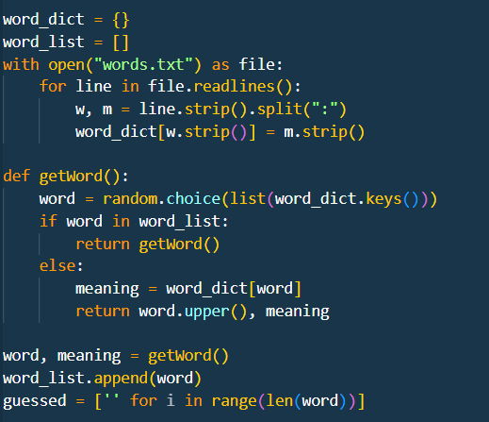

Slide 9
Upcoming 15 days status:
Merging all the levels in a single file.
Button will disappear on clicking ,if guess is wrong.
Displaying WIN or LOSE popup.

Slide 10
THANK YOU

